Slide 1
Neural Networks
Andrew Beatty
Andrew.Beatty@gmit.ie
Programming for cybersecurity

Slide 2
What are neural networks
Inspired by the brain,
Used for pattern matching,
They get trained

Slide 3
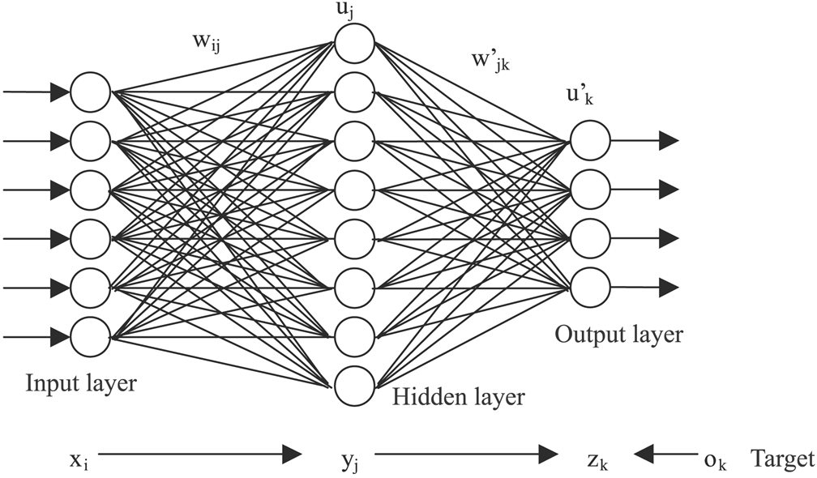

Slide 4
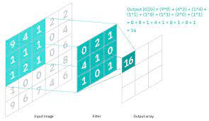
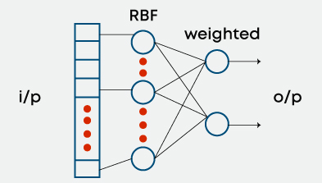
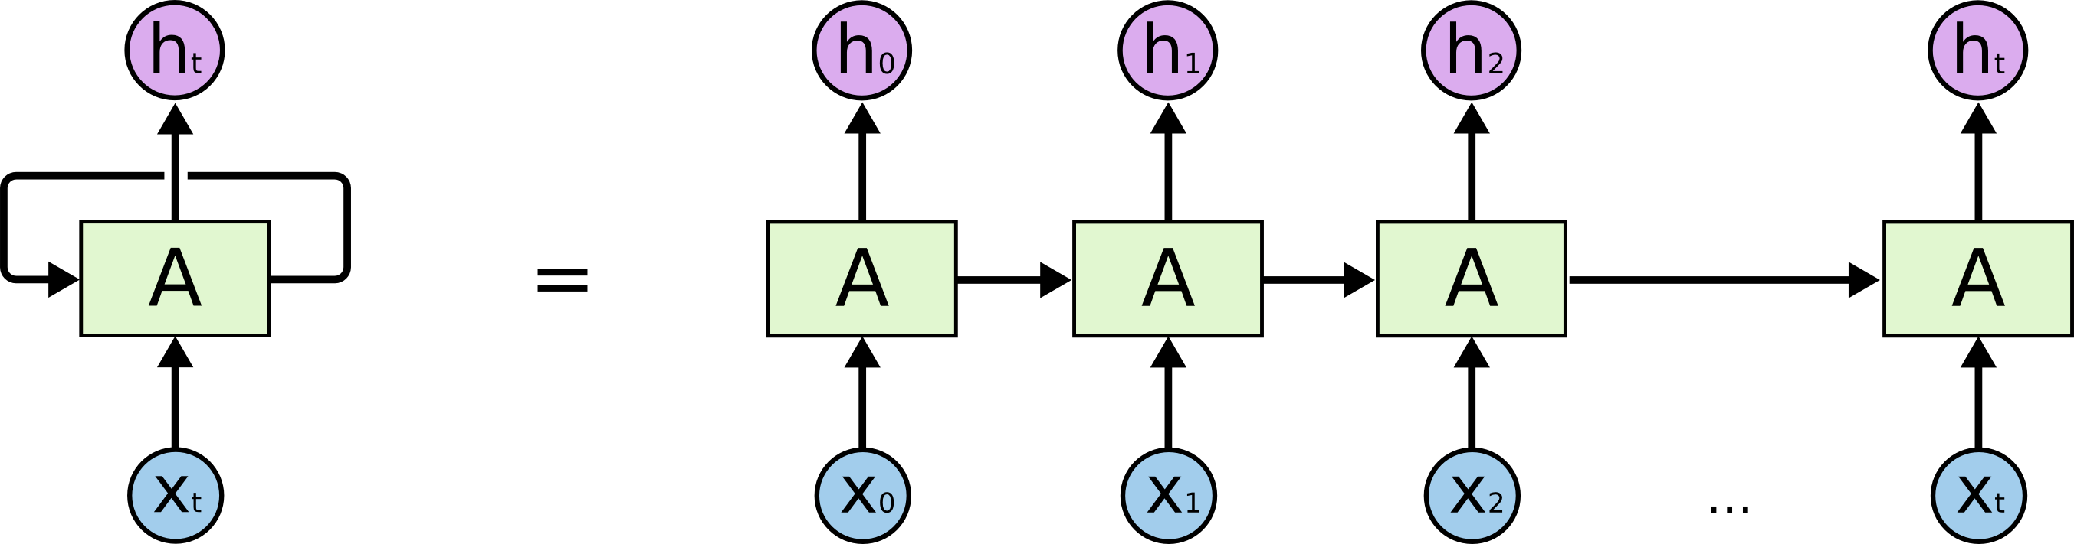
Lots of different architectures
Simple (dense, feed forward, perceptron)
convolutional neural network
Radial basis Neural networks
Recurrent Neural Networks (RNN)
And more

Slide 5
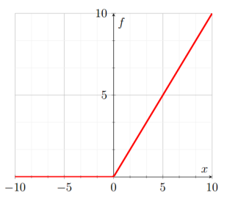
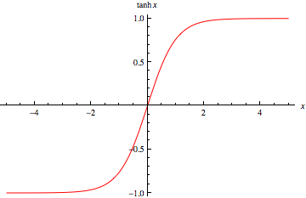
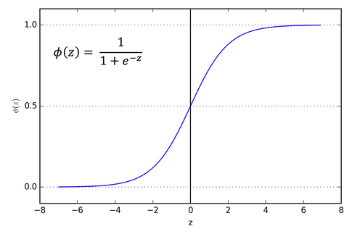
Data
Layers
Weights
Biases
Activation functions
Relu
Tanh
sigmoid
Backprobagation
Optimisers

Slide 6
Making a Neural net
Pre-processing the data
Just like other ML techniques
Create the net architecture
Compile that
Train
Test
And use to predict

Slide 7
Example (see github)
[[0. 0. 0. ... 0. 0. 0.]
[0. 0. 0. ... 0. 0. 0.]
[0. 0. 0. ... 0. 0. 0.]
...
[0. 0. 0. ... 0. 0. 0.]
[0. 0. 0. ... 0. 0. 0.]
[0. 0. 0. ... 0. 0. 0.]], [5 0 4 ... 8 4 8]

Slide 8
One image
[0. 0. 0. 0. 0. 0.
0. 0. 0. 0. 0. 0.
0. 0. 0. 0. 0. 0.
0. 0. 0. 0. 0. 0.
0. 0. 0. 0. 0. 0.
0. 0. 0. 0. 0. 0.
0. 0. 0. 0. 0. 0.
0. 0. 0. 0. 0. 0.
0. 0. 0. 0. 0. 0.
0. 0. 0. 0. 0. 0.
0. 0. 0. 0. 0. 0.
0. 0. 0. 0. 0. 0.
0. 0. 0. 0. 0. 0.
0. 0. 0. 0. 0. 0.
0. 0. 0. 0. 0. 0.
0. 0. 0. 0. 0. 0.
0. 0. 0. 0. 0. 0.
0. 0. 0. 0. 0. 0.
0. 0. 0. 0. 0. 0.
0. 0. 0. 0. 0. 0.
0. 0. 0. 0. 0. 0.
0. 0. 0. 0. 0. 0.
0. 0. 0. 0. 0. 0.
0. 0. 0. 0. 0. 0.
0. 0. 0. 0. 0. 0.
0. 0. 0.01171875 0.0703125 0.0703125 0.0703125
0.4921875 0.53125 0.68359375 0.1015625 0.6484375 0.99609375
0.96484375 0.49609375 0. 0. 0. 0.
0. 0. 0. 0. 0. 0.
0. 0. 0.1171875 0.140625 0.3671875 0.6015625
0.6640625 0.98828125 0.98828125 0.98828125 0.98828125 0.98828125
0.87890625 0.671875 0.98828125 0.9453125 0.76171875 0.25
0. 0. 0. 0. 0. 0.
0. 0. 0. 0. 0. 0.19140625
0.9296875 0.98828125 0.98828125 0.98828125 0.98828125 0.98828125
0.98828125 0.98828125 0.98828125 0.98046875 0.36328125 0.3203125
0.3203125 0.21875 0.15234375 0. 0. 0.
0. 0. 0. 0. 0. 0.
0. 0. 0. 0.0703125 0.85546875 0.98828125
0.98828125 0.98828125 0.98828125 0.98828125 0.7734375 0.7109375
0.96484375 0.94140625 0. 0. 0. 0.
0. 0. 0. 0. 0. 0.
0. 0. 0. 0. 0. 0.
0. 0. 0.3125 0.609375 0.41796875 0.98828125
0.98828125 0.80078125 0.04296875 0. 0.16796875 0.6015625
0. 0. 0. 0. 0. 0.
0. 0. 0. 0. 0. 0.
0. 0. 0. 0. 0. 0.
0. 0.0546875 0.00390625 0.6015625 0.98828125 0.3515625
0. 0. 0. 0. 0. 0.
0. 0. 0. 0. 0. 0.
0. 0. 0. 0. 0. 0.
0. 0. 0. 0. 0. 0.
0. 0.54296875 0.98828125 0.7421875 0.0078125 0.
0. 0. 0. 0. 0. 0.
0. 0. 0. 0. 0. 0.
0. 0. 0. 0. 0. 0.
0. 0. 0. 0. 0. 0.04296875
0.7421875 0.98828125 0.2734375 0. 0. 0.
0. 0. 0. 0. 0. 0.
0. 0. 0. 0. 0. 0.
0. 0. 0. 0. 0. 0.
0. 0. 0. 0. 0.13671875 0.94140625
0.87890625 0.625 0.421875 0.00390625 0. 0.
0. 0. 0. 0. 0. 0.
0. 0. 0. 0. 0. 0.
0. 0. 0. 0. 0. 0.
0. 0. 0. 0.31640625 0.9375 0.98828125
0.98828125 0.46484375 0.09765625 0. 0. 0.
0. 0. 0. 0. 0. 0.
0. 0. 0. 0. 0. 0.
0. 0. 0. 0. 0. 0.
0. 0. 0.17578125 0.7265625 0.98828125 0.98828125
0.5859375 0.10546875 0. 0. 0. 0.
0. 0. 0. 0. 0. 0.
0. 0. 0. 0. 0. 0.
0. 0. 0. 0. 0. 0.
0. 0.0625 0.36328125 0.984375 0.98828125 0.73046875
0. 0. 0. 0. 0. 0.
0. 0. 0. 0. 0. 0.
0. 0. 0. 0. 0. 0.
0. 0. 0. 0. 0. 0.
0. 0.97265625 0.98828125 0.97265625 0.25 0.
0. 0. 0. 0. 0. 0.
0. 0. 0. 0. 0. 0.
0. 0. 0. 0. 0. 0.
0. 0. 0.1796875 0.5078125 0.71484375 0.98828125
0.98828125 0.80859375 0.0078125 0. 0. 0.
0. 0. 0. 0. 0. 0.
0. 0. 0. 0. 0. 0.
0. 0. 0. 0. 0.15234375 0.578125
0.89453125 0.98828125 0.98828125 0.98828125 0.9765625 0.7109375
0. 0. 0. 0. 0. 0.
0. 0. 0. 0. 0. 0.
0. 0. 0. 0. 0. 0.
0.09375 0.4453125 0.86328125 0.98828125 0.98828125 0.98828125
0.98828125 0.78515625 0.3046875 0. 0. 0.
0. 0. 0. 0. 0. 0.
0. 0. 0. 0. 0. 0.
0. 0. 0.08984375 0.2578125 0.83203125 0.98828125
0.98828125 0.98828125 0.98828125 0.7734375 0.31640625 0.0078125
0. 0. 0. 0. 0. 0.
0. 0. 0. 0. 0. 0.
0. 0. 0. 0. 0.0703125 0.66796875
0.85546875 0.98828125 0.98828125 0.98828125 0.98828125 0.76171875
0.3125 0.03515625 0. 0. 0. 0.
0. 0. 0. 0. 0. 0.
0. 0. 0. 0. 0. 0.
0.21484375 0.671875 0.8828125 0.98828125 0.98828125 0.98828125
0.98828125 0.953125 0.51953125 0.04296875 0. 0.
0. 0. 0. 0. 0. 0.
0. 0. 0. 0. 0. 0.
0. 0. 0. 0. 0.53125 0.98828125
0.98828125 0.98828125 0.828125 0.52734375 0.515625 0.0625
0. 0. 0. 0. 0. 0.
0. 0. 0. 0. 0. 0.
0. 0. 0. 0. 0. 0.
0. 0. 0. 0. 0. 0.
0. 0. 0. 0. 0. 0.
0. 0. 0. 0. 0. 0.
0. 0. 0. 0. 0. 0.
0. 0. 0. 0. 0. 0.
0. 0. 0. 0. 0. 0.
0. 0. 0. 0. 0. 0.
0. 0. 0. 0. 0. 0.
0. 0. 0. 0. 0. 0.
0. 0. 0. 0. 0. 0.
0. 0. 0. 0. 0. 0.
0. 0. 0. 0. 0. 0.
0. 0. 0. 0. 0. 0.
0. 0. 0. 0. ]

Slide 9
To display we need to reshape it
tensor = tf.Variable(data, dtype=tf.float32)
img = tf.reshape(tensor, [28, -1])
plt.figure()
plt.imshow(img, cmap=plt.cm.binary)
plt.title(f"Excpected: { label}")
plt.xlabel(f"Guess: { guess}")
plt.colorbar()
plt.grid(False)
plt.show()

Slide 10
Make a network
model = keras.Sequential([
keras.layers.Flatten(input_shape=(784,1)), # input layer (1)
keras.layers.Dense(128, activation='relu'), # hidden layer (2)
keras.layers.Dense(10, activation='softmax') # output layer (3)
])
model.compile(optimizer='adam',
loss='sparse_categorical_crossentropy',
metrics=['accuracy'])

Slide 11
Train the network
model.fit(training_data[0], training_data[1], epochs=1)

Slide 12
Make predictions
predictions = model.predict(test_data[0])

Slide 13
Lets look at the code

